Slide 1
The ABCs of Blockchain 19 April 2017 Presentation to the Shareholders Services Association
Sajoo Samuel, SVP Product Development – Computershare
Jonathan Hoseman, Chief Information Officer – AST Financial
Moderator - Mark Kopelman, VP Strategy – Broadridge

Slide 2
DISCLAIMER
The information provided in this luncheon represents the current understanding of the presenters and the Shareholder Services Association.
It is subject to change. In no way should this information be construed or relied upon as legal or operational advice. You should consult with your own legal counsel, compliance officer and/or other subject matter experts.

Slide 3
“The blockchain will do to the financial system what the internet did to media”
Joi Ito, Neha Narula and Robleh Ali - Harvard Business Review
“I think [blockchain] is a fascinating area to keep an eye out for, but I think it’s being over-hyped right now… from the aspect of its short-term impact because there are still technical things that you need to solve and scale and there are still counter-aspects – business model wise – that aren’t necessarily fully clear.”
Peter Sondergaard, SVP Technology, Gartner

Slide 4
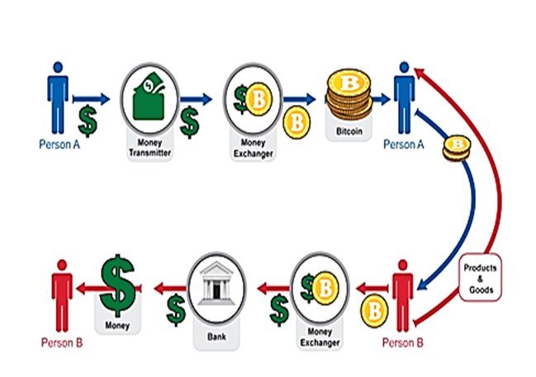
The origins of Blockchain – the Bitcoin currency and payment system
Blockchain was created to enable Bitcoin
Bitcoin is the first decentralized digital currency as it does not rely on a central government authority
Bitcoins are a “scarce asset”
Created through a “digital mining” process
Finite number of Bitcoins (21m), mined and unmined
Is Bitcoin a real currency?
Currency = A store of value, medium of exchange, and unit of account (Economists say “no, not yet”)
Why is there any sort of intrinsic value in a bitcoin?
Bitcoin is still an inherently volatile asset
Can it be collected, traded, and…. SPENT? (Hint– YES!)
As digital currencies evolve so too does the nature of money, banking, and worldwide financial transactions. These use cases are at the forefront of blockchain evolution
http://www.bestvpnservice.com/bitcoin-vpn.html

Slide 5
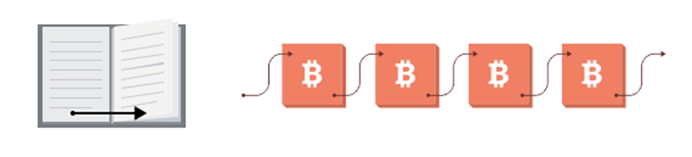
What is blockchain, and why does it matter?
A blockchain is a historical record of transactions, much like a database
Blocks in a chain = pages in a book. Each page in a book contains:
The text: the story
Each page has information about itself: title of the book, chapter title, page number, etc. (e.g. the “metadata”)
Similarly, in a blockchain, each block has:
A header which contains the data about the block: e.g. technical information, a reference to the previous block, and a digital fingerprint (aka “hash”) of the data contained in this block, among other things. This hash is important for ordering and block validation.
The contents of the block, e.g. information about the transaction(s)
“Bits on Blocks”, Blog by Antony Lewis, https://bitsonblocks.net/

Slide 6
Blockchain (Over)simplified
Blockchain is a distributed ledger that…
can contain financial and/or non-financial transactions
is replicated (distributed) across a number of systems in near real-time over a peer-to-peer network
Every participant “owns” the same copy of the ledger and gets updates when any transaction is added
Every participant helps determine the intrinsic “immutability” of all existing records
uses cryptography and digital signatures to prove identity, authenticity and enforce read/write access rights
has mechanisms to make it hard to change historical records, or at least make it easy to detect when someone is trying to change it

Slide 7
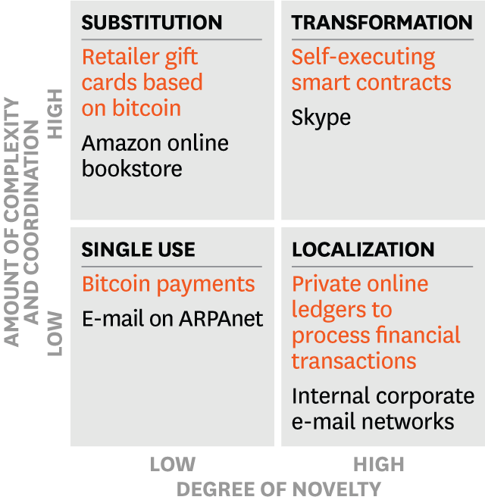
Contracts, Transactions and Recordkeeping in the Digital Age
The pace of innovation has not mirrored many of other technology-driven business advancements
All companies keep records of transactions but many have no “master ledger”, and further inefficiency is driven by intercompany workflow dependencies
Paradox #1: Contract management
Paradox #2: Securities trading: Speed of transactions vs. speed of settlement
Technology and business use case adoption – a function of novelty and complexity
“The Truth About Blockchain”, Iansiti & Lakhani,
Harvard Business Review, Jan-Feb 2017

Slide 8
Compelling Blockchain “Use Cases”
Smart Contracts
Digitizing law; contractual instruments
Execute commercial transactions and agreements automatically
Smart Assets
Trade finance, supply chain, workflow, rich data
Clearing and Settlement
Greater trade accuracy, and a shorter settlement process
Short-term win with real cost savings
Payment
Reducing friction (time & cost) from the current framework ACH, SWIFT
Speed up and simplify cross-border payments
Digital Identity
Register identity; re-use that identification for other services
IoT requires IoV; IoV requires MoIP to operate; machine-to-machine commerce

Slide 9
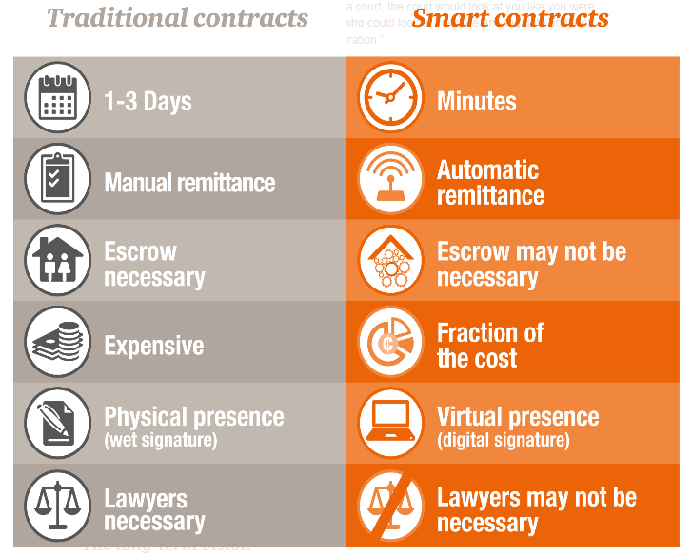
Traditional vs. Smart Contracts

Slide 10
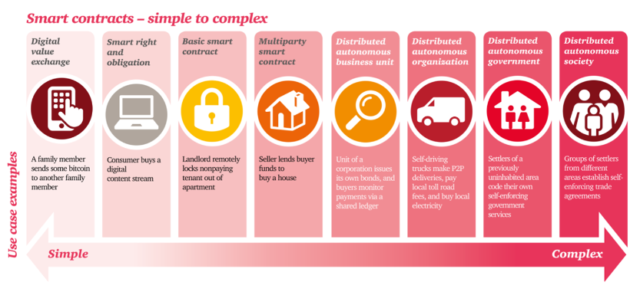
Smart Contracts

Slide 11
Blockchain and Shareholder Services
Ownership records
Ownership transfers including trade settlements
Payments likes dividends, interest, return of capital
Corporate Actions - splits, acquisitions & spin-offs
Proxy voting & tabulation
Basically anything related to value transfer and the record of ownership

Slide 12
How Should Issuers & Service Providers Approach Blockchain?
Deciphering the news– what to watch for
The rapidly changing landscape of commercial blockchain use cases
Their perceived importance and the maturity of thought
Actual implementations beyond “proof-of-concept”
The backing of large commercial players – solutions and platforms
Changes in the regulatory and compliance landscape (perspective, positioning, decisions)
The evolution of the blockchain value proposition in our domain(s)
Which use cases are getting traction?
Where are our companies placing bets through investigation, research, partnering and delivery
Engage in productive dialog between partners
Establish collective knowledge that benefits all shareholder services providers and their clients

Slide 13
Great Blockchain Resources
“Blockchain 101 – A Visual Demo” - https://www.youtube.com/watch?v=_160oMzblY8
“The Truth About Blockchain”, Harvard Business Review, https://hbr.org/2017/01/the-truth-about-blockchain
“Blockchain Basics: A Primer”, Pillsbury Winthrop Shaw Pittman LLP, https://www.pillsburylaw.com/images/content/1/0/v2/104160/AdvisoryMay2016CSTechBlockchainBasicsAPrimer.pdf
“Blockchain: The Invisible Technology That’s Changing the World”, PC Magazine, Feb 6, 2017, http://www.pcmag.com/article/351486/blockchain-the-invisible-technology-thats-changing-the-wor
“Bits on Blocks”, Blog by Antony Lewis, https://bitsonblocks.net/
“Blockchain and Smart Contract Automation”, PwC Technology Forecast, http://www.pwc.com/us/en/technology-forecast/blockchain.html

Slide 14
Questions & Comments
sajoo.samuel@computershare.com
cjutkiewicz@astfinancial.com
Mark.Kopelman@broadridge.com

Slide 15
Save The Dates
April 27th Webinar- STAMP & Medallion Program Basics:
Joint Webinar with the STA
May 18th Webinar- Preview of the SSA Annual Conference
June 8th Webinar- SSA’s Shareholder Services Professional Certificate Program
What, When, Where & How?
June 22nd Webinar- Is Your Company Ready for T+2?

Slide 16

2017 SSA Annual Conference
July 18-20, 2017
Bonita Springs, Florida

